Slide 1
A New PubMed
March 2020
[Presenter’s name here]
Notes:
[These slides were created by the National Center for Biotechnology Information (NCBI) and adapted by the Office of Engagement and Training (OET) at the U.S. National Library of Medicine.
We encourage you to copy and adapt these slides to your outreach and training needs and style appropriate to your audience. These slides are free of copyright restriction, but we appreciate attribution to the U.S. National Library of Medicine.
These slides were created at the end of September 2019 and updated in March 2020. Please keep your materials up to date by testing all examples and assertions using the new PubMed (https://pubmed.ncbi.nlm.nih.gov/), by monitoring the PubMed news via the NLM Technical Bulletin (https://www.nlm.nih.gov/pubs/techbull/), and by checking out the PubMed Trainer's Toolkit (http://www.nlm.nih.gov/oet/ed/pubmed/toolkit.html)
If you have questions or comments about these slides, please write to NLMTrainers@nih.gov.]

Slide 2
New PubMed
We are transforming PubMed into a modern hub with a fast, reliable, and intuitive search that connects people to the world's leading sources of biomedical information.
Notes:
NLM has built a new PubMed.
We are transforming PubMed into a “into a modern hub with a fast, reliable, and intuitive search that connects people to the world's leading sources of biomedical information.”
This new mission statement was the result of a collaboration between National Center for Biotechnology Information (NCBI – the producers of the PubMed system), Library Operations (responsible for MEDLINE journal selection and indexing), and NLM leadership.
The modernization of PubMed goes well beyond the interface: We are moving PubMed to the Cloud and rebuilding the entire infrastructure.
The system was built in an Agile development environment which incorporated user feedback, usability tests and analytics every step of the way. We’ve involved researchers, librarians, biocurators, clinicians, patient health advocates, and others. The approach allows us to build iteratively and integrate user feedback into the design.

Slide 3
The features you rely on…
Advanced search
Search details
Downloadable search history
Outside Tool icons
My NCBI custom filters
Links from the MeSH terms
Notes:
The new PubMed includes the features that you rely on.
This slide shows just a selection of those we’ve heard you have been most concerned about.
[Presenter may wish to highlight those relevant to the audience from a fuller list, below.]
Be assured that the features and functions you use in the old system are available in the new one, perhaps in a different location or with a different look. We will review those of particular interest, coming up.
Results-by-year graph
Filters
Send to collection
Send to clipboard
Send to My Bibliography
Save and Email results
Links from the journal title

Slide 4
…plus new features for a better experience
Preview snippets from the abstracts on the results page
Page from abstract to abstract
Navigate around a record using the sidebar
Cite in your preferred format
Share via social media or permalink
Display up to 5 Outside Tool icons
Access everything from your mobile device
Notes:
In addition to the features you’ve come to rely on, the PubMed includes some great display, navigation and output improvements.
It has a cleaner look; it is more intuitive and easy to use.
We’ll be talking about each of these in just a moment.
Note that about half of PubMed’s traffic is now coming from mobile devices, so the truly responsive site allows us to much more capably meet the needs of mobile users, including with the ability to link from mobile devices to library subscriptions via the Outside Tool.

Slide 5
…plus enhanced retrieval
Better sensors
Added synonymy, including plural forms
Improved British/American mapping
Unlimited truncation
Improved Best Match brings the best results to the top!
Notes:
We’ve also been able to apply new retrieval features in the new PubMed.
We have:
improved (and are continually improving) citation and other sensors.
enhanced the synonymy, including plural forms
improved British/American mapping,
removed our limits on truncation;
We’ll look briefly at all of these in a few minutes.
[click] The Best Match sorting algorithm will bring the most relevant results to the top of your search results.
[More about Best Match: https://www.ncbi.nlm.nih.gov/labs/pubmed/help/#best-match-algorithm]

Slide 6
PubMed best practices have not changed
Looking for some good articles about a topic?
Enter your search terms into the search box
Be specific
No search tags or ANDs needed
Avoid quotation marks
Avoid truncation (*)
Looking for a specific, known article?
Let the citation sensor work for you
Notes:
To find articles by topic, enter your words or phrases into the search box without quotation marks or fancy syntax (e.g., treatment incidental adenocarcinoma or preventing head lice in schools). Let PubMed’s term mapping and always-improving retrieval algorithms do the work for you. Your best matches will be at the top of your results.
[Note 1: You can check the term mapping by viewing your search details from the Advanced screen. If PubMed fails to find a map from your medical search terms to MeSH, try synonyms for your concepts for better results.]
[Note 2: Comprehensive searching, as is done in a systematic review, requires a deeper investigation into the MeSH terminology for your concepts as well as a thorough exploration of synonyms used by authors in non-indexed records. Consult a health sciences librarian for assistance. ]
To find articles by citation, enter the citation elements you have (author, title words, journal, volume, year, etc.) and let PubMed’s citation sensor find the article for you (e.g., neale science 2019).
To find articles by author, search the author’s last name and initials (e.g., fagerness j).
To find articles by journal, use the complete journal title, ISSN or title abbreviation (e.g., lancet oncol).

Slide 7
Timing
In November 2019, new PubMed was formally announced by NLM
In spring 2020, new PubMed will become the default
Both legacy and new PubMed run in parallel for several months
Legacy PubMed will be retired after that
And that’s just the beginning
Notes:
In November of 2019, NLM formally announced the launch of the new PubMed.
The new PubMed will become the default in spring of 2020 (exact date still TBA). All links to PubMed will be redirected to the new system.
The new and legacy PubMed will run in parallel for several months, but we hope people will quickly transition to the new one.
After several months, the legacy system will be retired.
[click] And the new PubMed will continue to be improved with your use and input.

Slide 8
Still to come…
These tools will go to the new PubMed when it is the default:
Search from the MeSH database
Search from NLM Catalog
Clinical Queries
Single Citation Matcher
Batch Citation Matcher
My NCBI will direct to the new PubMed – saved searches, alerts will not need to be recreated.
A New PubMed API
And more…
Notes:
At the time that the new system becomes the default, all links to PubMed will redirect to the new system. This includes all of the associated tools built for PubMed searching, including the MeSH Database, the NLM Catalog, Clinical Queries, the Single Citation Matcher and the Batch Citation Matcher.
My NCBI will also redirect to the new PubMed. All of your saved searches and alerts will function – you won’t need to do anything to prepare.
At a future date we will release a new PubMed API. This is still in development stages.
And, again, we will continue to actively improve PubMed based on your use and feedback.

Slide 9
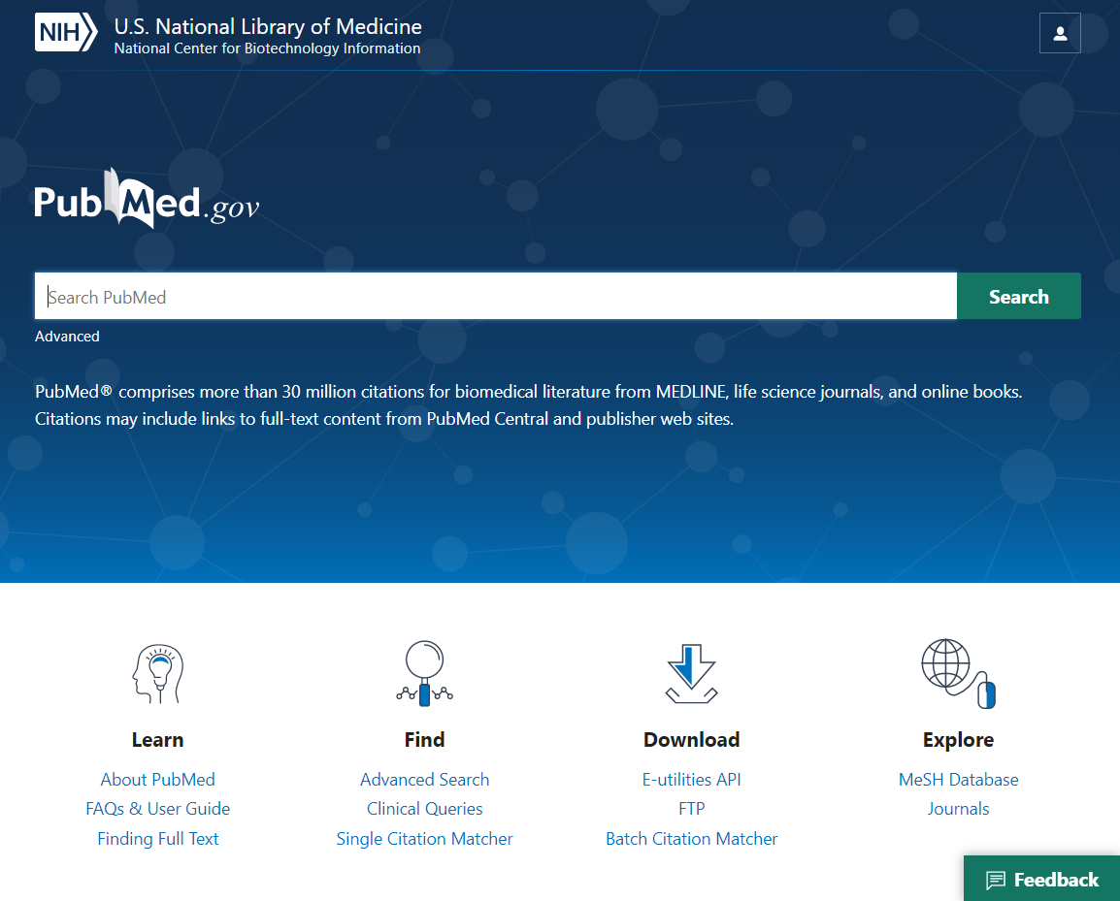
Try the new PubMed
https://pubmed.ncbi.nlm.nih.gov
Searches
Known Item
Subject
Author
Notes:
[A live demo is suggested for the following parts, but use the slides if you prefer.]
Now we’ll explore the new features I very quickly mentioned while demonstrating that your search strategies remain the same. We’ll look at known item, author and subject searches.
We’ll start with a known item search.

Slide 10
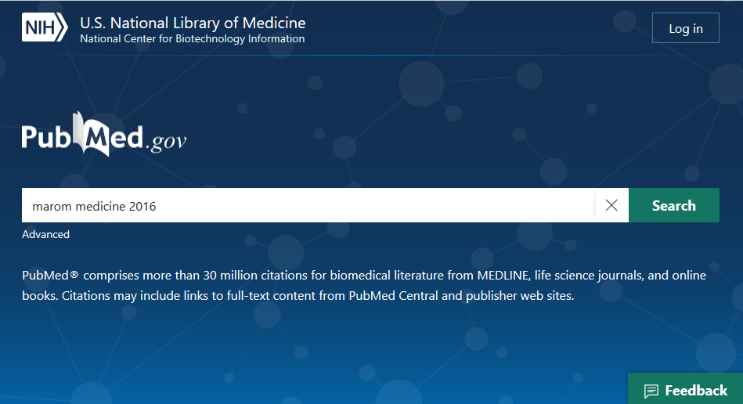
Known Item Search: marom medicine 2016
Notes:
To remind you of our always-improving citation sensor, we’ll start with an example that combines an author, journal title and publication date: marom medicine 2016.

Slide 11
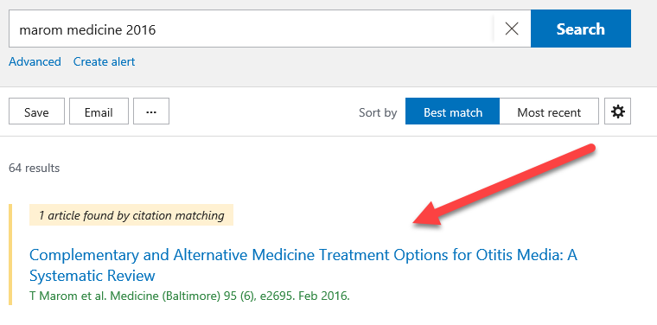
Known Item Search: marom medicine 2016
Notes:
Just as with our legacy system but continually improved, the PubMed citation sensor matches our citation elements with the most likely record.

Slide 12
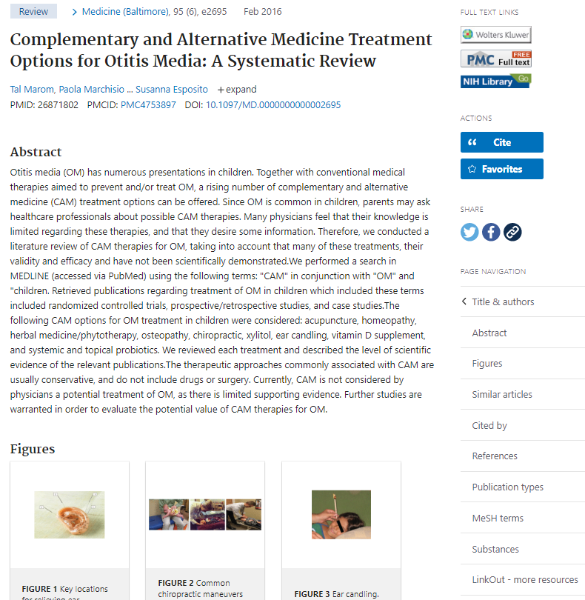
Sidebar Menu
Full Text Links
Publisher icon
PMC icon
Up to 5 Library icons
Cite
Add to Favorites
Share
Page Navigation
Notes:
Exploring this record highlights some of the features of the new system:
The new PubMed sidebar menu has four main components:
[click] Your links to the full text, including up to 5 Outside Tool icons, to bring you and your patrons to your institution’s online subscriptions.
[click] Quick ways to save the citation information: The new Cite button, which I’ll show you in just a moment, and your Favorites button, which saves the citation to My NCBI.
- [click] Our social media links provide you a link back to PubMed, so you can easily share information with your colleagues on Twitter or Facebook.
[click] A navigation menu, to quickly get you to the part of the record of interest.

Slide 13
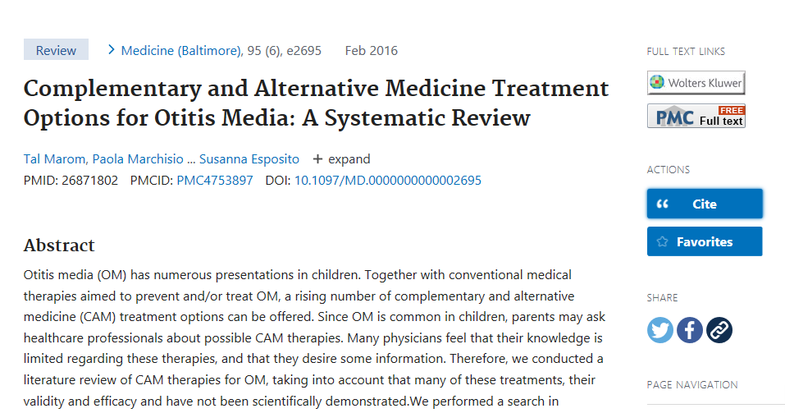
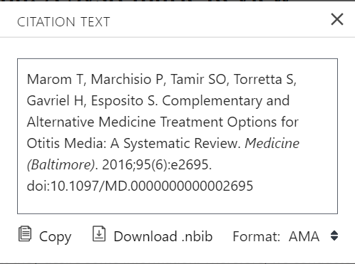
Cite
Citation in AMA, MLA, APA, and NLM formats
Copy citation text
Download .nbib
Notes:
I’d like to show off the new Cite feature, in particular. This feature is available on the results page and on the abstract screen. It was previously only available in PubMed Central.
This Cite feature allows you to easily generate a properly-styled citation in AMA, MLA, APA or NLM citation format. You can also download the citation in .nbib format, which is a standard citation format used widely in reference management software.

Slide 14
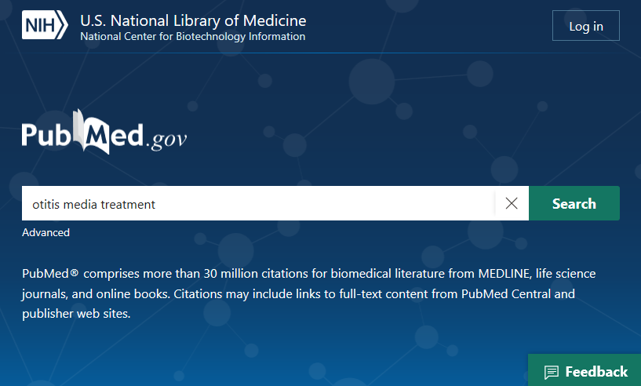
Subject Search: otitis media treatment
Notes:
Again, to reinforce that searching works the same way as in legacy PubMed – with a few enhancements - let’s try a subject search. We’ll search: otitis media treatment

Slide 15
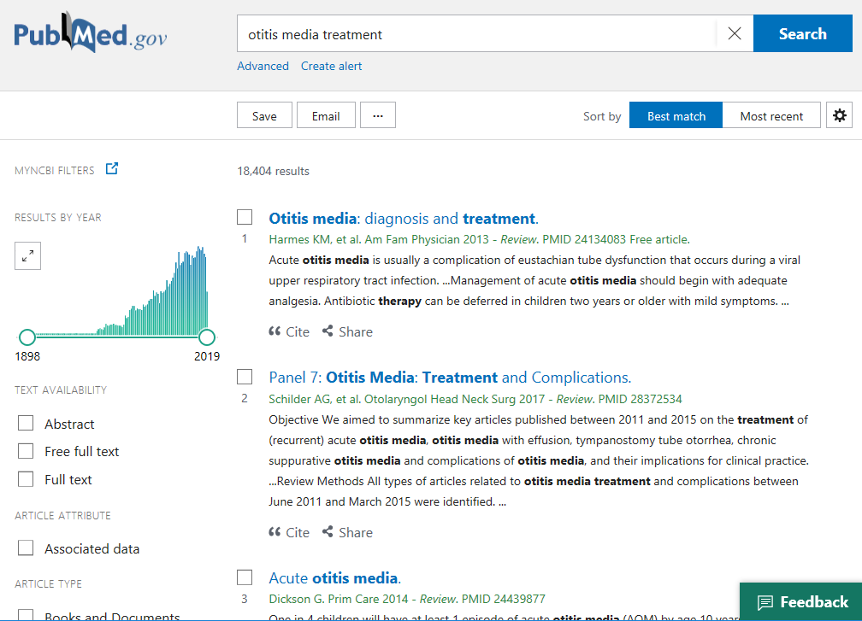
Results Page
Results by Year graph
Save, Email, Send to
Best Match by default
Abstract snippets with highlights
Filters
Advanced search
Create alert
Cite and Share
Notes:
We’re striving for a cleaner, easier-to-use results page while maintaining full functionality.
[click] The Results by Year graph shows the number of records by date of publication. The slider allows you to select your range of interest.
[click] The export options at the top left offer you three ways to copy PubMed records to other places: Save, Email and Send.
[click] The Best match default sort order brings the most relevant records to the top of your results.
[click] You can now see snippets from the abstract where your search terms or terms mapped from your search terms appear.
[click] Your filters are available where you’d expect, in the left column.
[click] Advanced search – where you will find your search details – is linked from the top.
Create your alerts as usual from below the search box.
[click] The cite and share buttons are available from here as well as the abstract screen.

Slide 16
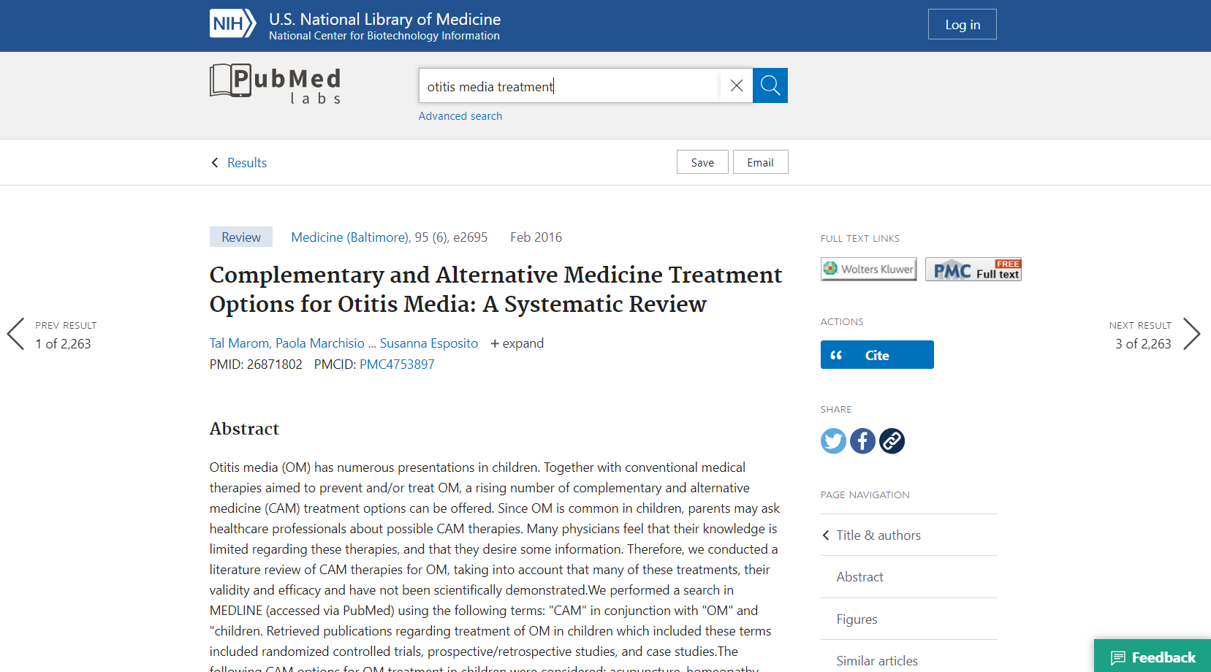
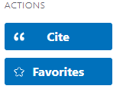
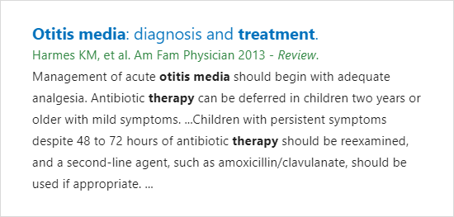
Previous & Next
< Previous
> Next
Hover for details
Notes:
At long last, you can now page through your PubMed results from the abstract screen.
[click] Also, if you hover your cursor over the previous result or next result arrow, an excerpt from the previous or next result will pop up.

Slide 17
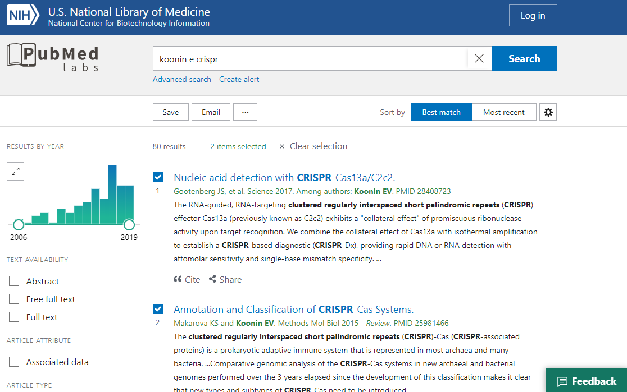
Save and Email results
Notes:
[click] Using Save, Email and Send to work in a familiar way to the legacy PubMed.

Slide 18
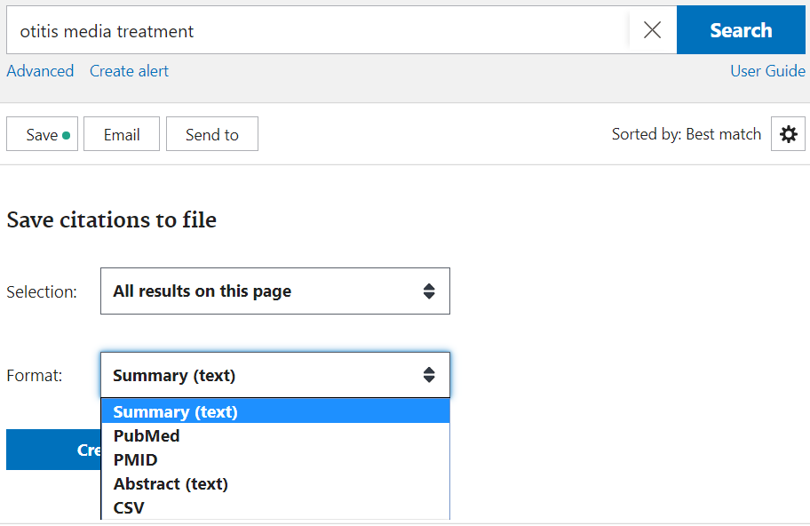
Save to File - Options
Selection
All results on this page
All results (up to 10K)
Selection
Format
Summary
PubMed
PMID List
Abstract
CSV
Notes:
To export records to your reference management software, use Send to File and select the PubMed format.
CSV format is also available.

Slide 19
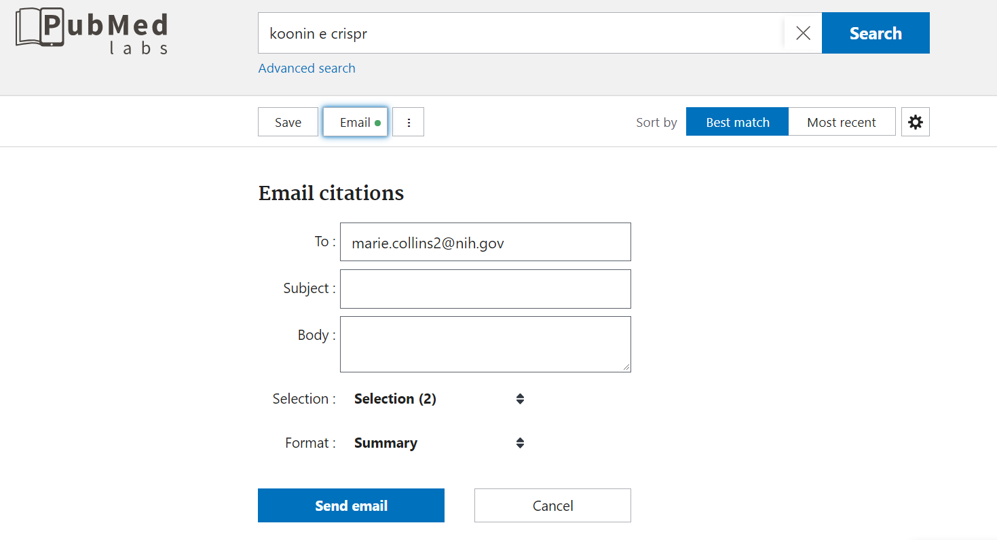
Email - Options
Selection
All results on this page
Selection
Format
Summary (Text)
Summary
Abstract (Text)
Abstract
Notes:
Your email options are also familiar.

Slide 20
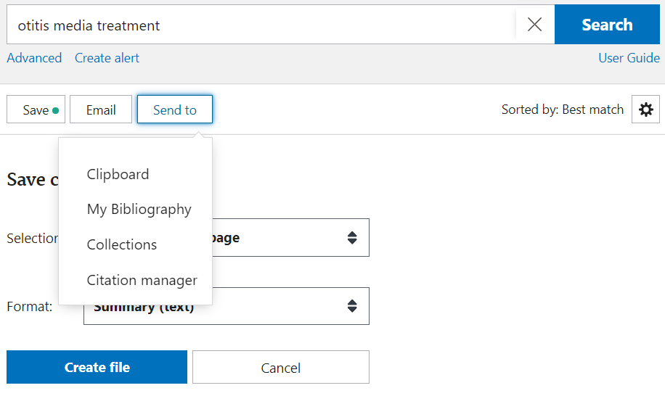
More Actions Menu
Send to
Clipboard
My Bibliography
Collections
Notes:
Click on the ellipsis to access your Send options:
add up to 500 citations to a temporary Clipboard while reviewing results of one or more searches.
save to My Bibliography, or
add up to 1,000 citations to a Collection in your My NCBI account while reviewing results of one or more searches, or
export citations in PubMed format as an .nbib file, which can be used by many citation management programs.

Slide 21
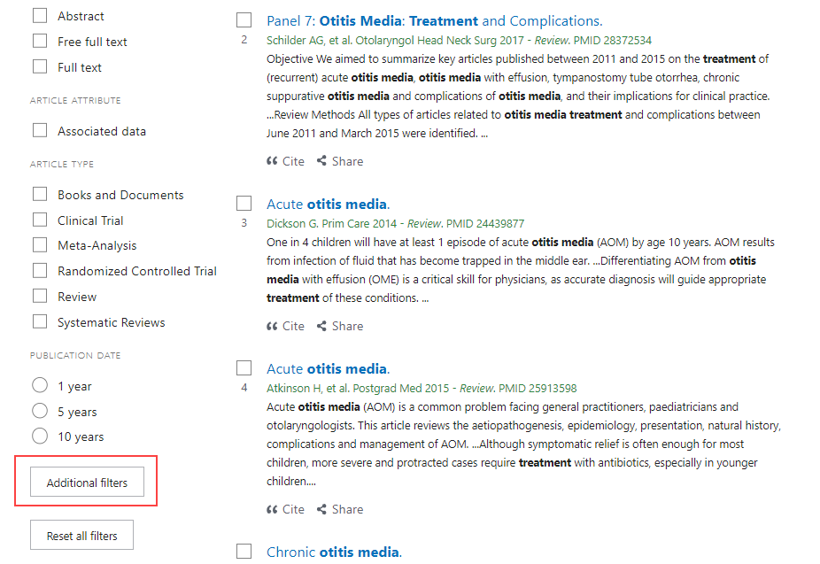
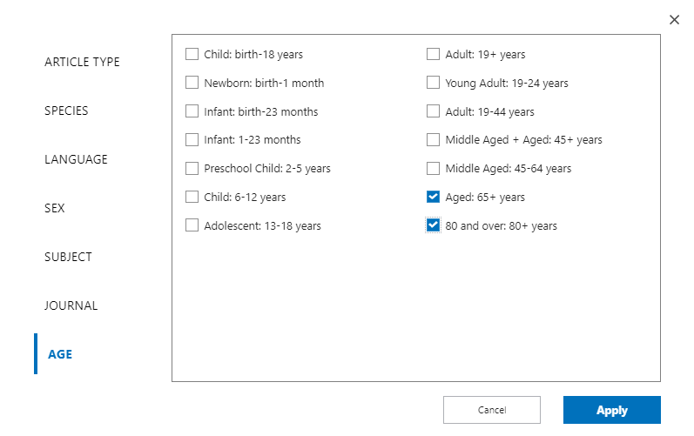
Filters
Click on Additional Filters
Select a category
Check the filters
Click “Apply”
Notes:
Your text access, article type and publication date filters appear by default, and other filters are available from the [click] Additional filters button at the bottom.

Slide 22
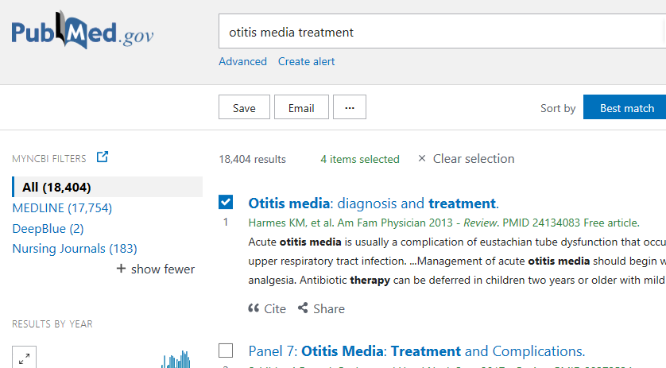
My NCBI Custom Filters
Notes:
You can also use your favorite custom filters, set in your NCBI account.

Slide 23
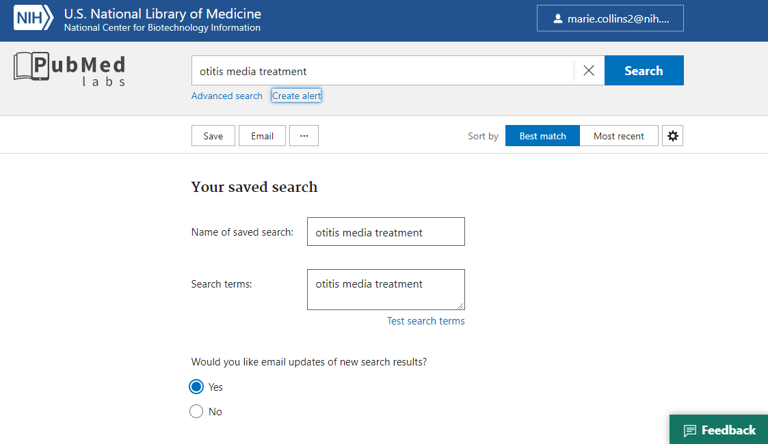
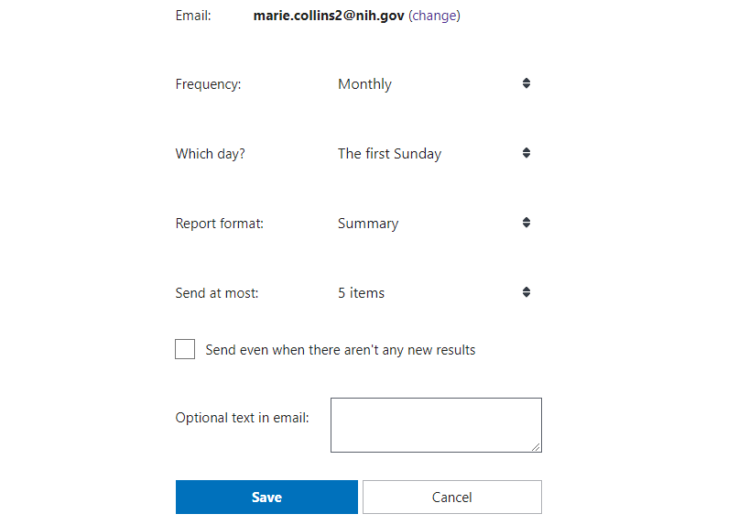
Create Alert
Save search
Create alert
Specify frequency
Specify format
Notes:
Save your searches and create alerts, [click] specifying your frequency and format.

Slide 24
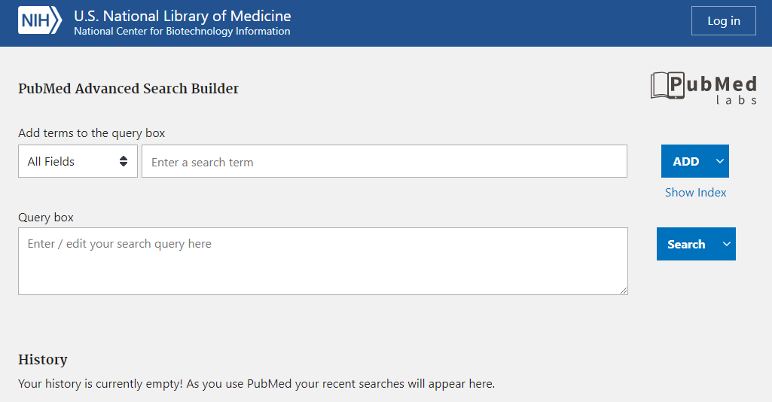
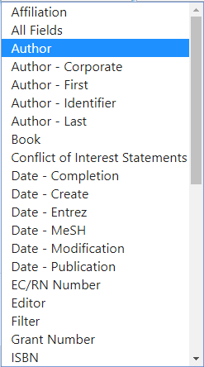
Advanced Search and History
Search specific fields
Show index
Build complex searches
Powerful tool for advanced users
Notes:
The Advanced Search page includes all of the robust functionality you are accustomed to with PubMed, including the ability to Show the complete indexes for searchable fields.

Slide 25
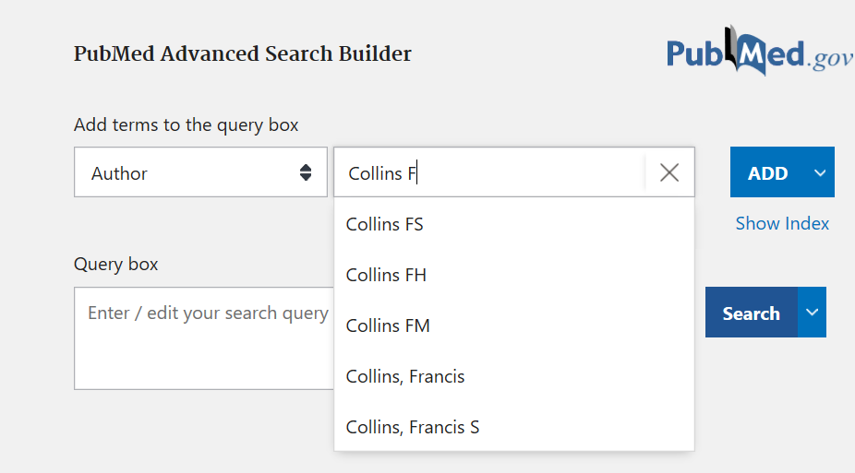
Advanced Search and History
Includes author and journal index autocomplete features
Notes:
Not new, but you may have overlooked the autocomplete features in both the author and journal indexes.
If you want to know the name variations searchable in PubMed or need help finding the complete journal title, the Advanced Search page is the place to go.

Slide 26
Search History
View and Download search history
Compare results of various searches
Combine previous searches
View search details
Download Search History
Notes:
Your Search History is found below the Search Builder on the Advanced page.
Here you can view, combine, compare and download your previous searches.
[click] This is also where you will find your Search Details.

Slide 27
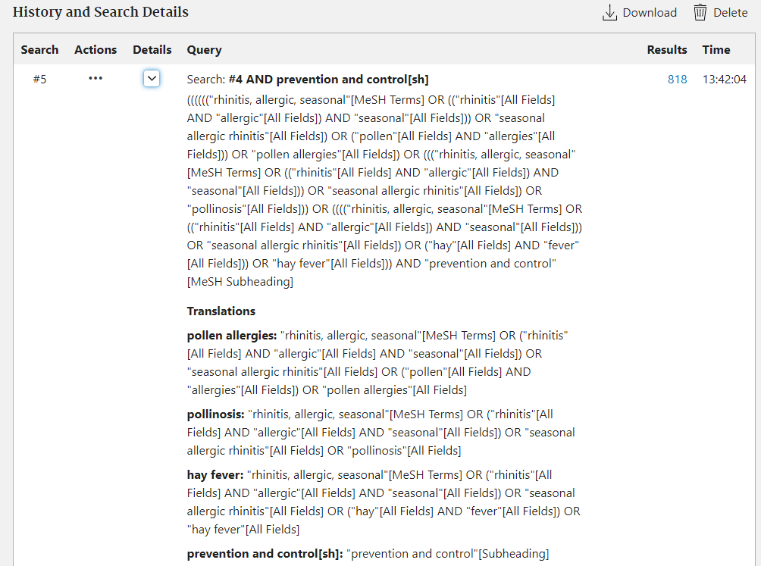
Search Details
View search details and translation
Notes:
The Search details show your search term translations, including the improvements we’ve added to the new system.
Let’s talk about those retrieval improvements.
[Note: A common question is whether you can edit your Search Details. To edit, you will need to copy and paste your Search Details from here to the search box.]

Slide 28
New retrieval features
Improved sensors
Enhanced synonymy, including plural forms
Enhanced British/American mapping
Unlimited truncation
Notes:
I mentioned that we’ve been able to apply new retrieval features in the new PubMed.
We’ve already talked about the citation sensor; let’s look at the rest of these.

Slide 29
New Retrieval Features: Enhanced Synonymy
Notes:
In addition to the familiar automatic term mapping to MeSH, the new PubMed includes additional useful synonymy, including plural forms.

Slide 30
New Retrieval Features: Better British/American Mapping
Notes:
The new PubMed system comes with improved mapping between British and American spelling, so you don’t have to worry about including the variant forms in your search.

Slide 31
New Retrieval Features: Unlimited Truncation
Notes:
Whereas the legacy PubMed used only the first 600 variations of a truncated stem, the new PubMed features unlimited truncation.

Slide 32
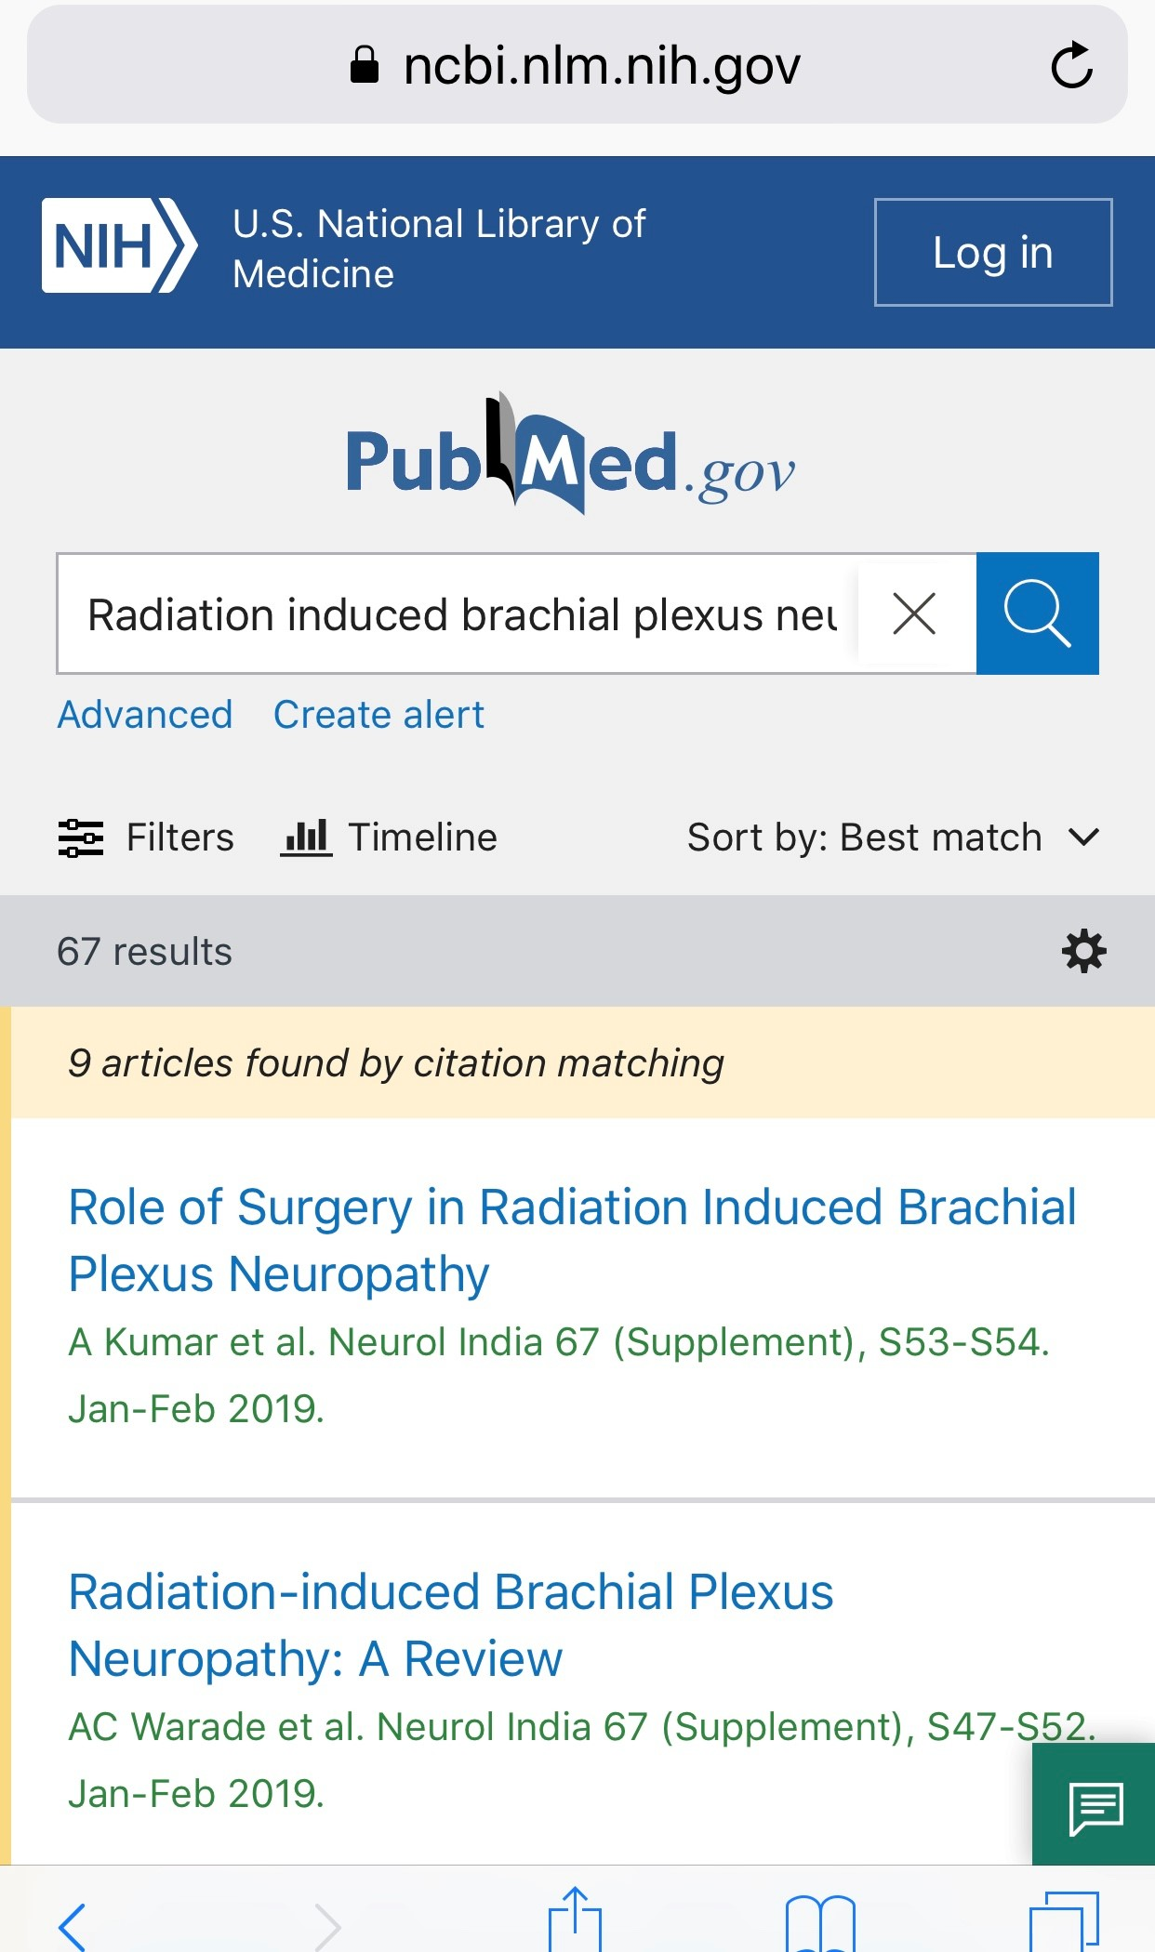
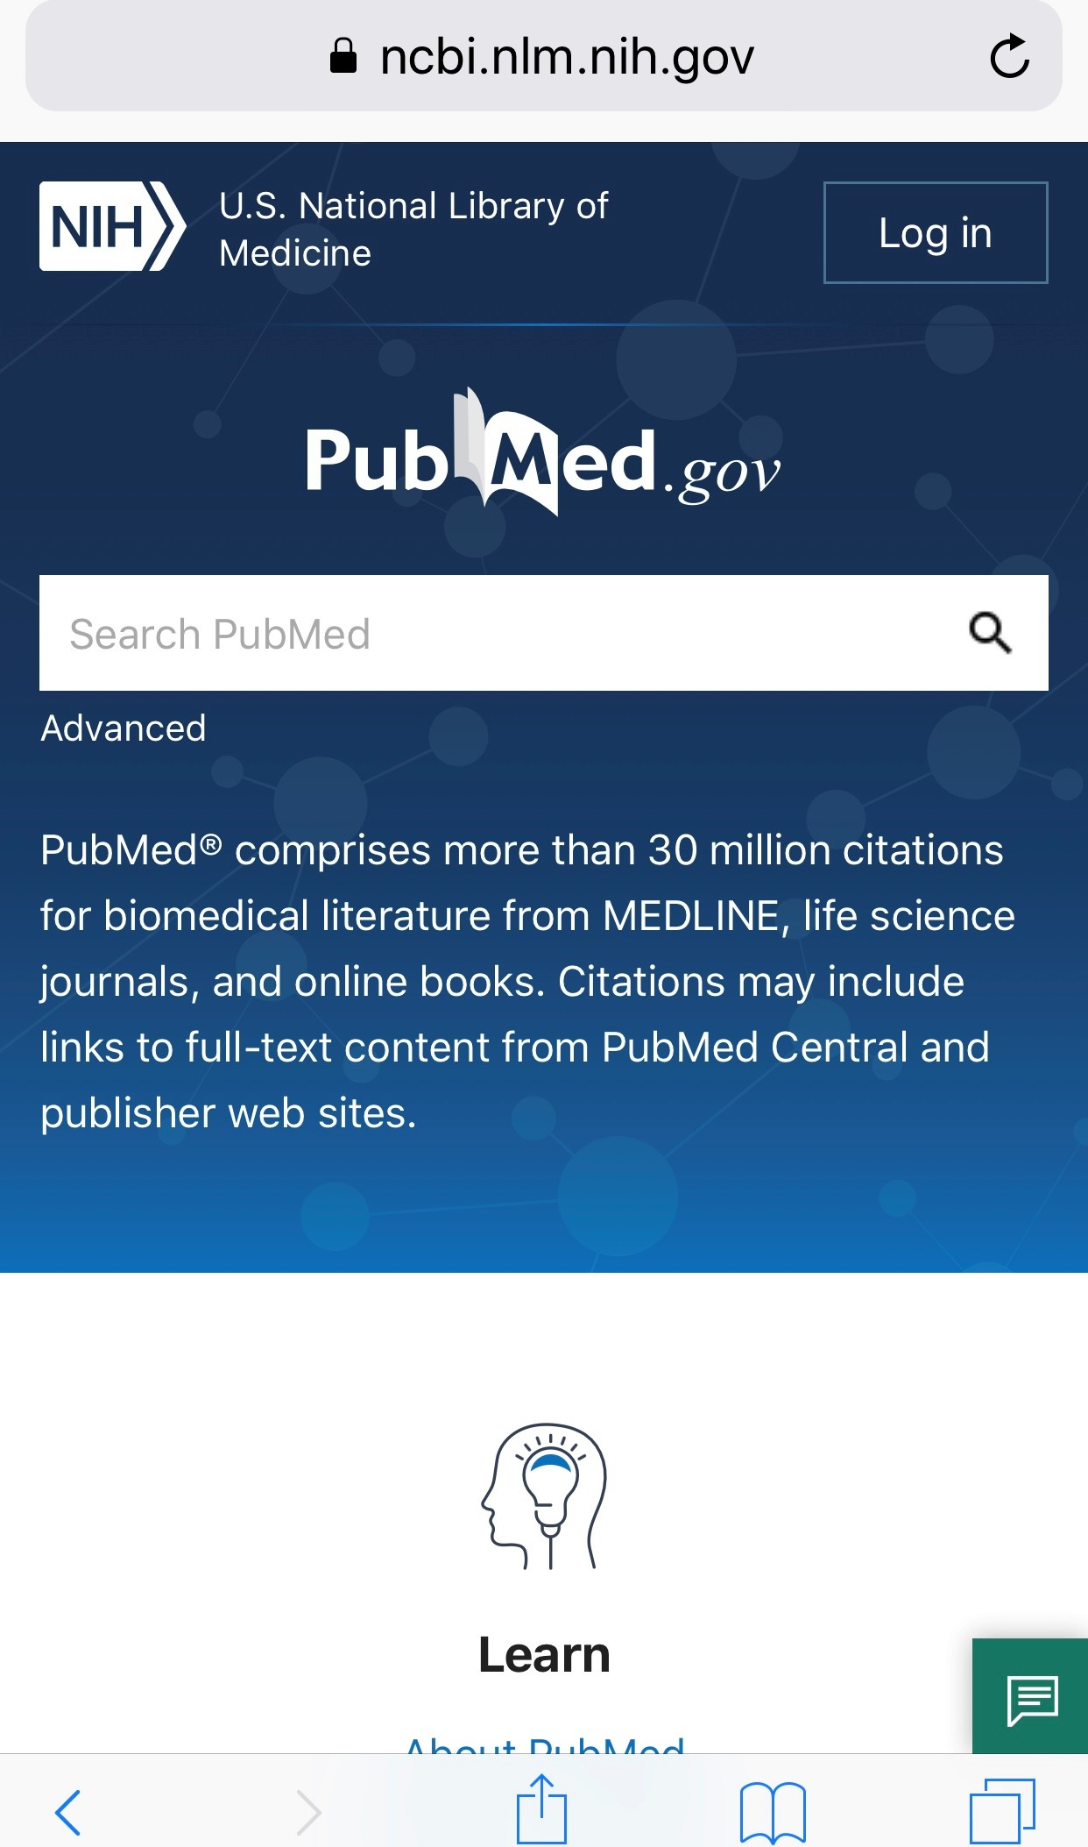
It’s all on mobile, too!
Log in to My NCBI
Advanced search
Filters
Timeline
Sort order
Cite
Share
Publisher and PMC icons
Outside Tool icons
Notes:
Mobile users make up about half of the users of PubMed, [click] so we’re particularly excited to offer the full functionality of PubMed on a mobile device.

Slide 33
Key Points: New PubMed
is available now at https://pubmed.ncbi.nlm.nih.gov
is richly featured with the functions you rely on
has the same trusted citation data
can be searched the same way as the legacy system
has improved retrieval
boasts great new display, navigation and output features in a truly responsive design
will be continually improved over time
Notes:
Key Points to know about the new PubMed:
The new PubMed is available now at https://pubmed.ncbi.nlm.nih.gov
NLM officially announced the launch of the new PubMed in November 2019. The new PubMed will be the default system sometime in spring 2020.
The legacy PubMed system will be available for some months following the launch.
The new PubMed is richly featured, including Advanced Search, Search details, Search history, filters, My NCBI, links from MeSH, and more.
The new PubMed has the same trusted citation data as the legacy system.
Best search practices are the same as with the legacy system
Improvements to retrieval include enhanced synonymy, addition of plural forms, better British/American translations, and unlimited truncation. Try your searches in PubMed Labs now.
The new PubMed boasts some great new display, navigation and output features in a truly responsive design that facilitates mobile access, including to the full text when available from the publisher, PMC or your library (via Outside Tool).
Once the new PubMed system is the default, all links to PubMed will be redirected and run in the new system. This includes searches from the MeSH Database, the NLM Catalog, Clinical Queries, the Single Citation Matcher, and the Batch Citation Matcher.
PubMed will be continually improved over time, informed by usage and your feedback.

Slide 34
Communication and Planning
Watch for Updates:
PubMed in the NLM Technical Bulletin
PubMed in the NCBI Insights Blog
New PubMed Home Page
NLM and NCBI Social Media
Training from the National Network of Libraries of Medicine
Notes:
The official source for NLM product news is the NLM Technical Bulletin. Sign up for alerts to keep up to date.
You can also find information on PubMed Labs in the NCBI Insights Blog.
The PubMed Home Page will host banners with alerts about the new PubMed.
We’re planning on increasing our presence on Twitter.
Watch for training for librarians and other information specialists from the National Network of Libraries of Medicine. Sign up for new class alerts at nnlm.gov.

Slide 35
Questions?
Notes:
Questions?

